Slide 1

Detecting Malicious Domains and IPs by Fusing Threat Feeds and Passive DNS through Graph Inference
findervid.com/admin 195.154.34.135 stopwell.org/cp.php?m=login
havephun.org/frmcp1 rus99.net/se/logs 195.208.185.49
198.12.153.10 mmmoney1.com/panel/ sagradiana.net/lin/
Emily Heath, PhD
Eric Harley
The MITRE Corporation
Approved for Public Release; Distribution Unlimited. Case Number 17-4450

Slide 2




Current Problems
Analysts are inundated with threat feeds, indicators, network data, analytic results, etc.
Besides handling the volume, there are other problems with using this information efficiently
Timeliness
Coordinating and combining data
Intuition: threat actors re-use infrastructure and tend to get their infrastructure from similar places
Analysts anticipate being able to pivot from one known malicious domain to more, or to malicious IPs
How can analysts exploit this intuition and move from flagging what is already known to be malicious to identifying new maliciousness?

Slide 3
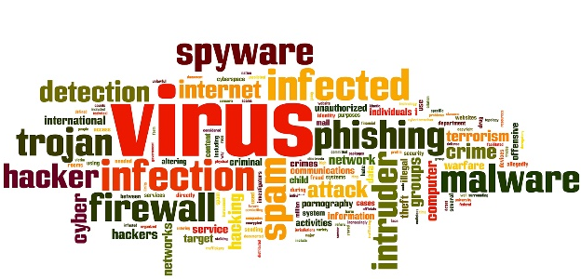

Using the Intuition
Idea: the digital neighborhood of an unknown domain or IP can be used to estimate its likelihood of being malicious
Homophily: birds of a feather flock together
Unknown domains and IPs associated with known malicious domains and IPs are more likely to be malicious
Known maliciousness could come from any information source
Information can be propagated throughout the network to uncover new maliciousness
Formal method: graph inference
Domain 1
IP 1
Known Bad
IP 2
Domain 2
IP 3
Known Good
Domain 3
IP 4
IP 5
Domain 4
Unknown
IP 6

Slide 4



Belief Propagation Algorithm (BPA)
BPA: Graph inference method for estimating a node’s marginal probability
Prior knowledge for some nodes (known states)
Statistical dependencies between nodes (homophily or heterophily)
Nodes pass messages to neighbors each round
Messages: vectors with an entry for each state
Entry contains sender’s perception of the recipient’s
likelihood of being in that state
Synchronous update schedule: messages in one iteration depend upon messages in previous iteration
After message passing, final belief values can be computed for each node
Beliefs: vectors with final value for each state
With threshold, values can be used to assign a label to a node
Messages from i’s other neighbors
i
j
Messages from j’s other neighbors
Final beliefs
Label

Slide 5
BPA for Malicious Domains and IPs
Build a bipartite graph of domains and IPs
Include edge if domain resolves to IP
Use passive DNS data to construct
Modify key parameters of interest
Seed size of known labels
Number of iterations
Strength of relationships between nodes
Threshold values for label decisions
Seed the graph with some known labels
Two states: malicious and benign
Test as a semi-supervised learning problem
Measure percentage improvement in baseline true positive rate (TPR)
Malicious Labels
-Threat Feeds
-Analytic Outputs
Benign Labels
-Alexa Domains
-Umbrella List
Domains
IPs
Initial Known Bad
BP Identified Bad

Slide 6
Using Real Data
Data set constructed from following:
Censys data set for passive DNS
Threat feeds for malicious labels
hpHosts EMD by Malwarebytes
Malware Domain Blocklist
CyberCrime Tracker
Alexa & Umbrella lists for benign labels
Surprise issue: underflow in message/belief computations
Source: nodes with high numbers of neighbors
Resolution: Two implementations
Decimal package approach
Log-space transformation approach
Optional feature to “shuffle” order of neighbors
Network Statistics
No. of Edges | 2,120,375
No. of Nodes | 152,904
Max node degree | 22,432
Average node degree | 27.89
Median node degree | 2
Min node degree | 1

Slide 7
General Results
Worst results: BPA gives the same TPR (0% improvement)
Dependent on threshold
Best results: 400% and 900% improvement
Moderate thresholds, strong or asymmetric relationship strengths

Slide 8
Algorithmic Comparisons
Decimal Implementation
Decimal: Python package for representing numbers exactly
Resolves underflow by performing computations exactly
Log-Space Implementation
Use logs of values and log identities to perform computations
Resolves underflow by performing computations with numbers far from 0
Shuffling option implemented for both methods
Randomizes order of contribution from neighbors
Run Time Comparisons
 | Decimal (No Shuff.) | Decimal (Shuff.) | Log-Space (No Shuff.) | Log-Space(Shuff)
Time (Messages) | ~11 h 1 iteration ~22 h 2 iterations | ~12.5 h 1 iteration ~25 h 1 iterations | ~1.5 h 1 iteration ~3 h 2 iterations | ~3.5 h 1 iteration ~6.5 h 2 iterations
Time (Beliefs) | ~26 sec | ~30 sec | ~15 sec | ~20 sec
*Statistical testing confirmed all approaches agreed in terms of actual results (message and belief values)

Slide 9


Challenges & Areas for Future Work
Continuing to improve speed
Building in more prior knowledge
Expanding inferences to registrars, BGP ASNs
Updating pDNS data, “known” labels
Infrastructure that is both malicious and benign
Threat Feeds
Registration Information
Certificate Information
Analytics
Prior Probability Malicious
Prior Probability
Benign

Slide 10
Conclusions
BPA shows a lot of potential for identifying previously unknown malicious domains and IPs quickly and accurately
Simplicity of algorithm allows for multiple sources of information to be effectively fused
Computational considerations resulting from messy real data can be handled efficiently in different ways
Various open areas allow analysts the opportunity to tune the approach to their environment

Slide 11
Thank you! Questions?

